Slide 1
Glycolysis

Slide 2
Graded Quiz Question
How does insulin help glucose enter an adipocyte?
Active transport through GLUT1
Active transport through GLUT4
Passive transport through GLUT1
Passive transport through GLUT4

Slide 3
Graded Quiz Question
Which enzyme has a an affinity for glucose closer to the physiological range:
Glucokinase
Hexokinase
Phosphofructokinase
GLUT4
Notes:
A

Slide 4
Graded Quiz Question
Which of the following is a target for glucagon dependent regulation in the liver?
GLUT2
PFK1
PFK2
Hexokinase
Notes:
Answer is PFK2

Slide 5
Graded Quiz Question
Why is fructose more lipogenic than glucose
It is a disaccharide and therefore has more energy content
It promotes insulin secretion more potently than glucose
Its catabolism skips several metabolic control points
Fructose is primarily metabolized in the adipose tissue

Slide 6
Graded Quiz Question
What statement is not true of GALT?
It can be treated by limiting galactose in the diet
It can be treated by ingestion of lactase
Children can be given soy-based formula
Leads to an accumulation of galactose-1-phosphate

Slide 7
Glycolysis Learning Objectives
Describe the relative roles of glycolysis, gluconeogenesis, the TCA cycle as central nodes of nutrient metabolism.
Explain the enzymatic differences and tissue distributions of glucokinase vs hexokinase and why this is important.
Understand how ATP is produced from glycolysis, and the efficiency of aerobic vs non-aerobic glycolysis
Understand the key points of regulation of glycolysis and how these regulatory points are controlled, notably how glucokinase/hexokinase, PFK1 and PK are regulated including what signals are important in which tissues.
Describe the potential fates of pyruvate, and what dictates the next steps in its metabolism
Explain how non-glucose carbohydrates such as galactose and fructose enter glycolysis, and how their point of entry affects how they are regulated.

Slide 8
What happens to sugars inside the body
Only monosaccharides are transported into the blood, mainly
Glucose
Fructose
Galactose

Slide 9
Postprandial Glucose Disposal
What happens if glucose is not effectively transported into the muscle?
Type 2 Diabetes
DeFronzo, R. A. Lilly lecture 1987. The triumvirate: beta-cell, muscle, liver. A collusion responsible for NIDDM. Diabetes 37, 667–687 (1988).

Slide 10
Individual Differences in Glycemic Response
Zeevi, D. et al. Personalized Nutrition by Prediction of Glycemic Responses. Cell 163, 1079–1095 (2015).

Slide 11
Substantial Individual Variance in Glycemic Responses Across Foods
At your table: What could explain some of the food-specific differences between individuals in terms of their glycemic response

Slide 12
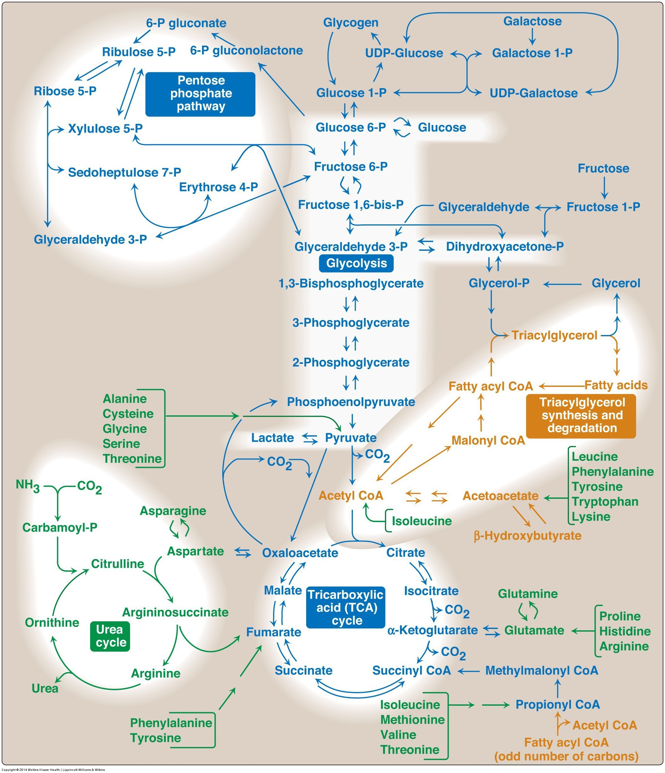
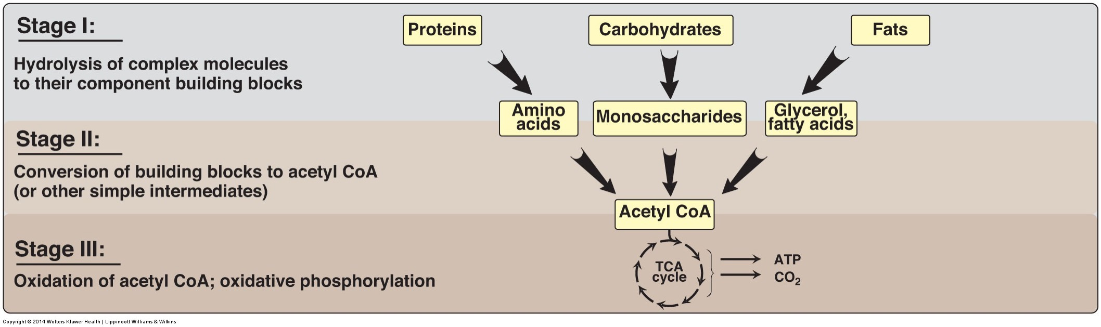
CHO Metabolism Overview

Slide 13
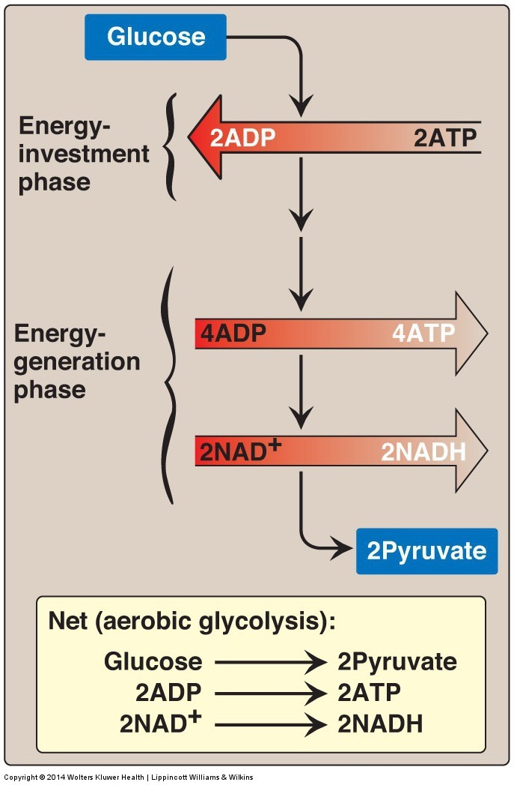
Glycolysis
Main pathway of monosaccharide degradation
Main tissue sites
Liver, muscle
Occurs in cytoplasm of the cell
Glucose conversion to two 3-carbon products: pyruvate

Slide 14
Staring with the End
End product: two pyruvates
Aerobic Conditions
Becomes Acetyl-CoA
In presence of CHO but need energy -> TCA Cycle -> Energy
In presence of CHO but don’t need energy -> Lipids -> Storage
In absence of CHO (relevant for lipid oxidation)
Ketone Bodies (if OAA is absent)
Gluconeogenesis (via pyruvate carboxylase, if Acetyl-CoA is high)
Anaerobic conditions
Becomes lactate
Lactate goes to liver for reconversion back to glucose
Notes:
Absent of CHO is mo

Slide 15
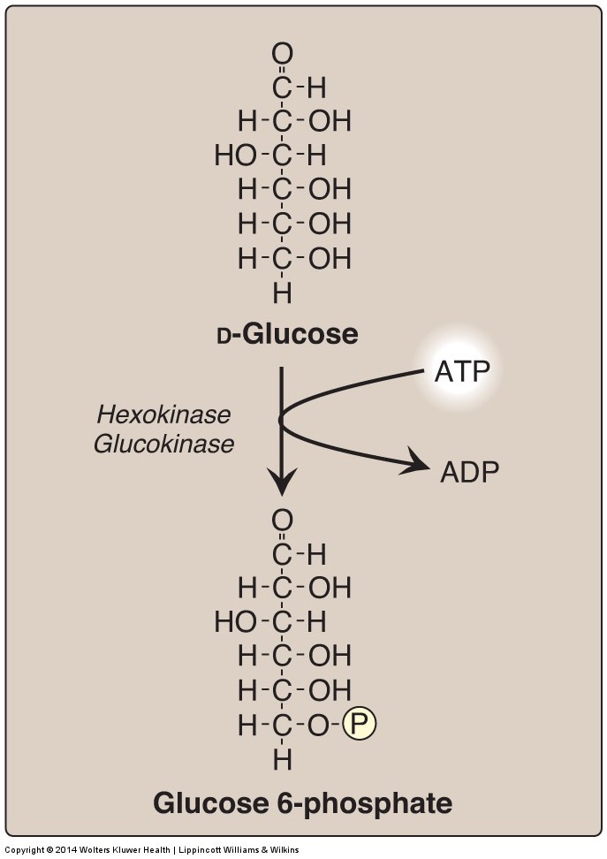
Generating Glucose-6-Phosphate
Traps glucose in the cell
Consumes ATP
Reversible by Glucose-6-Phosphatase (in liver)

Slide 16
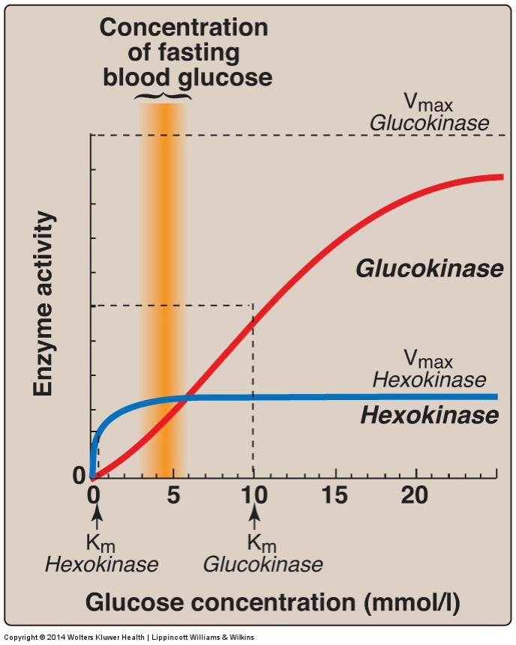
Glucokinase vs Hexokinase
Enzyme | Tissue | Regulation | Kinetics
Glucokinase | Liver/Pancreas |  | Co-operative/Fast
Hexokinase | Fat/Muscle | -G6P | High Affinity
What is the advantage of these different kinetics in these tissues?

Slide 17
Activity – Glucokinase and MODY
Work in groups on these questions
MODY: Mature-Onset Diabetes of the Young
Monogenic form of Type 2 Diabetes
Segregated with Inactivating mutations in GCK (Froguel et al. Nature 1992, Hattersley et al. Lancet 1992)

Slide 18
Pedigree
Affected Male
Question 1: Is this a dominant (A) or recessive (B) trait?
Enter your answer with your iClicker
Affected Female

Slide 19
What is the mechanism?
Glucokinase is expressed in beta cells (A), and in liver cells (B). Which seems more likely to be causing MODY?

Slide 20
Typical Pathophysiology
Velho, G. et al. Identification of 14 new glucokinase mutations and description of the clinical profile of 42 MODY-2 families. 217–224 (1997).

Slide 21
What is going on?
What are the significant differences between subjects with MODY (GCK variants) and without?
Are the islets more (A) or less (B) sensitive to glucose levels?
Draw a curve estimating glucokinase activity vs glucose levels in normal and MODY subjects.

Slide 22
An activating variant in GCK
Familial
Hyperinsulinemia
Hypoglycemia
Hyperinsulinemia
MODY

Slide 23
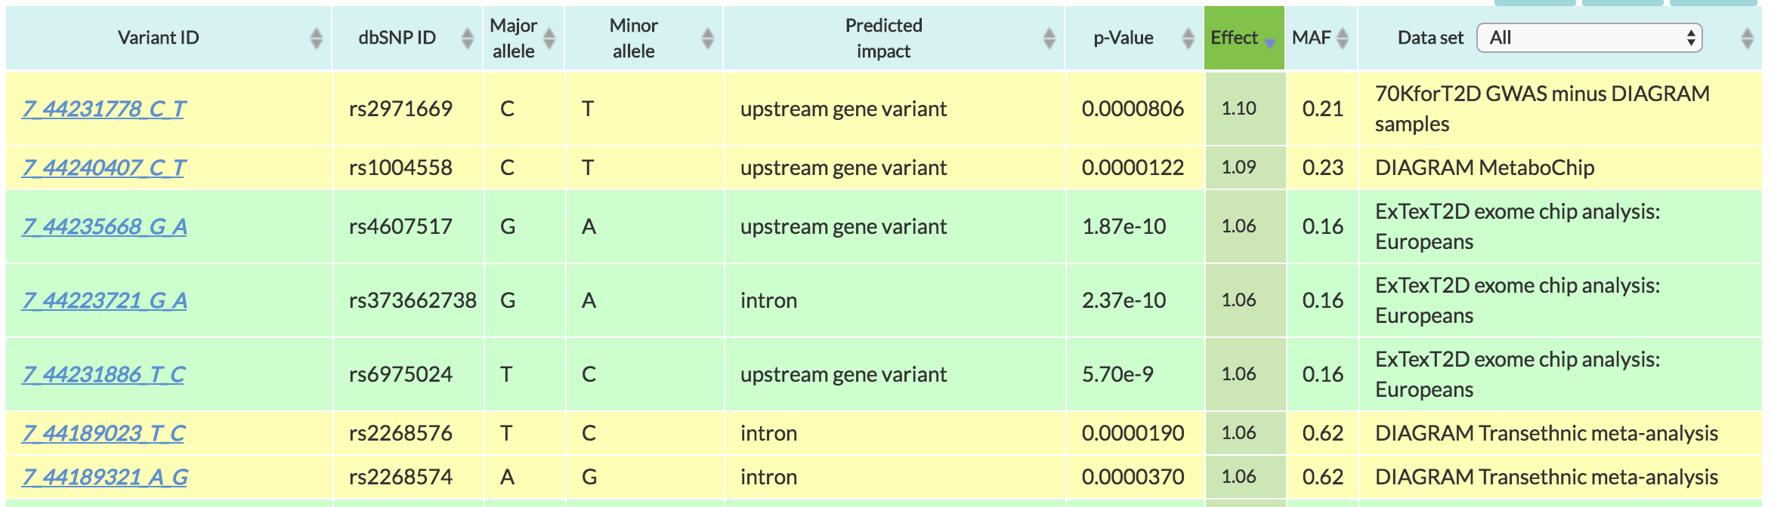
Common Variants in GCK
MAF: Mean allele frequency (0-1), is how common this variant is
Effect: 1.10 means 10% increase in risk of Type 2 diabetes
http://www.type2diabetesgenetics.org/gene/geneInfo/GCK

Slide 24
Fates of Glucose-6-Phosphate
GS: Glycogen synthase
PFK1: Phosphofructokinase 1
G6PDH: G6P Dehydrogenase

Slide 25
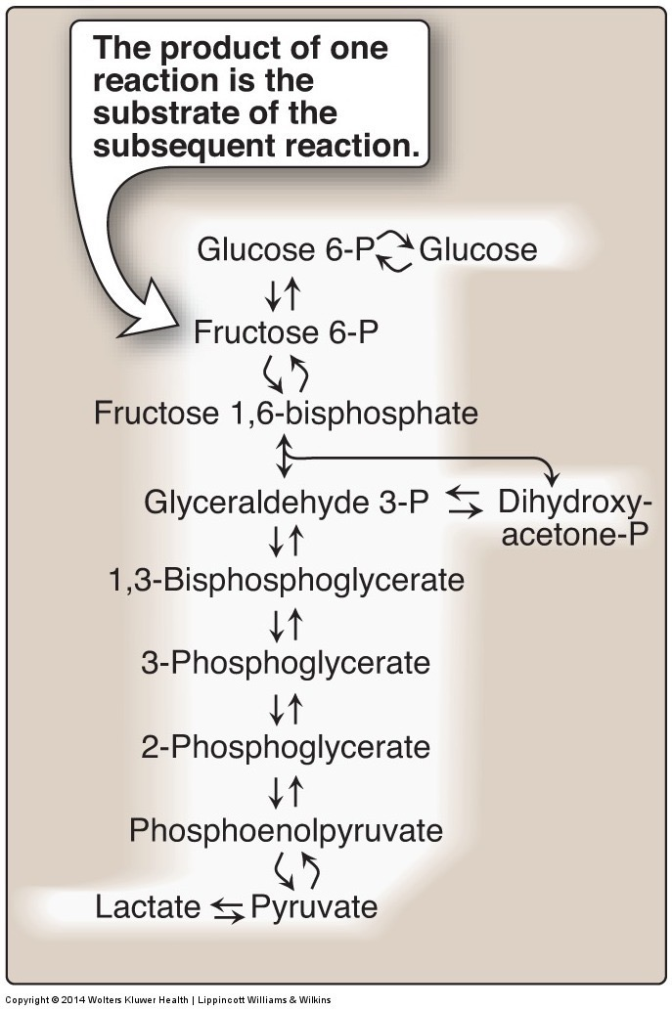
The Next Regulated Step is PFK1

Slide 26
Tarui’s Disease
Loss of the PFK1 isoform in Muscle (PFKM)
Symptoms include
Muscle weakness
Increased glycogen in muscle
Myopathy
Possible treatments?
Notes:
Treatment usually entails that the patient refrain from strenuous exercise to prevent muscle pain and cramping. Avoiding carbohydrates is also recommended

Slide 27
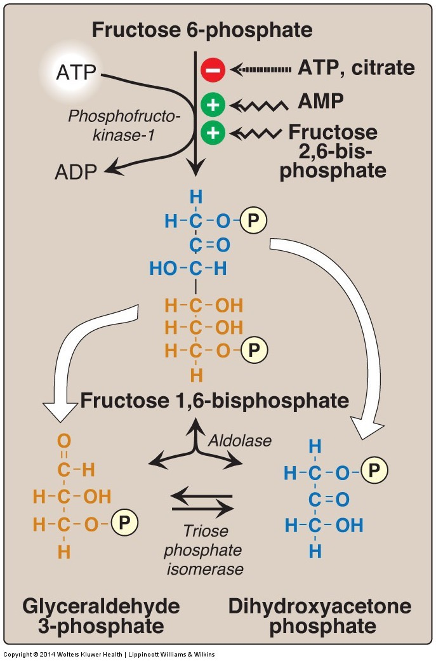
Regulation of PFK1
Priority of regulators
F26bP
AMP
ATP
Citrate

Slide 28
Allosteric Regulation of PFK1
F6P is held constant here
Mansour TE. Studies on Heart Phosphofructokinase : Studies on Heart Phosphofructokinase : Inhibition , and Activation. J. Biol. Chem. 1963;238(7):2285–2292.

Slide 29
Regulation by F-2,6bP

Slide 30
OK… so what controls PFK2 and F26bP?
Adrenaline
Glucagon
Insulin

Slide 31
What is the point of all this?
Buildup of TCA cycle intermediates can slow glycolysis (Citrate)
That can be over-ridden by energy needs (ATP/AMP)
BUT glucose flux can over-ride energy needs (F26bP)
AND hormones can over-ride glucose flux (PFK2 inhibition, reducing F26bp)

Slide 32
Tissue Specificity in PFK2 Regulation
Glucagon/Adrenaline can phosphorylate and inhibit Liver PFK2 but not Muscle PFK2
PFK-2 isoforms
Pourquoi?

Slide 33
At your table
Under what conditions is glucagon elevated
What does glucagon do?
Why would glucagon blocking PFK2 be useful in the liver?
Why would this not be useful in the muscle?

Slide 34
The third regulated step in glycolysis is Pyruvate Kinase
Substrate mediated ADP phosphorylation
Notes:
Other example of substrate mediated phosphorylation is phosphoglycerate kinase

Slide 35
How is Pyruvate Kinase Regulated
Control by macronutrient availability
If a liver has an excess of amino acids, glucose oxidation will stop.

Slide 36
Post-Translational Regulation of Pyruvate Kinase
Alanine inhibition only in liver

Slide 37
Tissue Specific Regulation of Glycolysis Summary
Component | Liver | Muscle
Glucokinase/Hexokinase | Not inhibited by G6P | Inhibited by G6P
Phosphofructokinase | Inhibition of PFK-2 (regulates via F26bP) | PFK-2 not inhibited by phosphorylation
Pyruvate Kinase | Inhibition of PK by alanine and by phosphorylation | PK not inhibited by alanine or phosphorylation

Slide 38
Transcriptional Regulation of Glycolysis
Hypoxia (HIF)
Carbohydrate sensing (ChREBP – L-PK)
Chronic glucagon (CREB - GK)

Slide 39
Glycolysis Net ATP
Note: NADH is energy equivalent to 3 ATP (from the ETC)
Energy Consuming Reactions:
Reactions 1: 1 ATP
Reaction 3: 1 ATP
Energy Generating Reactions:
Reaction 6: 1 NADH x 2 (2.5 ATP x 2 = 5 ATP)
Reaction 7: 1 ATP x 2 (2 ATP)
Reaction 10: 1 ATP x 2 (2 ATP)
Net Energy Gain:
4 ATP + 2 NADH minus 2 ATP = 7 ATP generated from glycolytic breakdown of glucose

Slide 40
Glucose Net ATP
Glucose to Pyruvate
+7 ATP/Glucose
Glucose to Lactate
7 ATP – 5 ATP
2x NADH used
Net + 2 ATP/glucose
Glucose to CO₂
32 ATP/Glucose

Slide 41
Energy Stress and Glycolysis
We have discussed 2 ways in which elevated low energy can activate glycolysis, do you remember what they are?
AMPK can regulate glycolysis, think of an example of how it could do this

Slide 42
Fructose and Galactose

Slide 43
Fructose Consumption and Metabolic Health

Slide 44
Liver Fructose Metabolism
Skips the regulatory steps of Glucokinase and PFK2

Slide 45
Lack of Control of Fructose Metabolism

Slide 46
Importance of Citrate Feedback on PFK1
Citrate is part of lipid synthesis pathway
For glucose and galactose, but not fructose, citrate blocks flux.

Slide 47
Fructolysis Differences
Fructose glycolysis in liver begins with FK
Bypasses two important regulatory step in glycolysis
Reaction 1 (glucokinase)
Reaction 3 (phosphofructokinase)
Pyruvate products may be shifted to pathways involved in fatty acid or cholesterol synthesis
Production of uric acid due (maybe) to ATP depletion

Slide 48
Inherited Disorders of Fructose Metabolism
Fructokinase mutations
Fructose not trapped in the cell
Elevated fructose in the blood
Generally not pathological
Aldolase B mutations
Buildup of Fructose-1-phosphate
Impaired gluconeogenesis and glycogenolysis
High risk of hypoglycemia

Slide 49
Galactolysis
Is Galactolysis regulated by PFK1
Yes
No

Slide 50
Glycolysis Learning Objectives
Describe the relative roles of glycolysis, gluconeogenesis, the TCA cycle as central nodes of nutrient metabolism.
Explain the catalytic differences and tissue distributions of glucokinase vs hexokinase and why this is important.
Understand how ATP is produced from glycolysis, and the efficiency of aerobic vs non-aerobic glycolysis
Understand the key points of regulation of glycolysis and how these regulatory points are controlled, notably how glucokinase/hexokinase, PFK1 and PK are regulated including what signals are important in what tissues.
Describe the potential fates of pyruvate, and what dictates the next steps in its metabolism
Explain how non-glucose carbohydrates such as galactose and fructose enter glycolysis, and how their point of entry affects how they are regulated.

